Slide 1
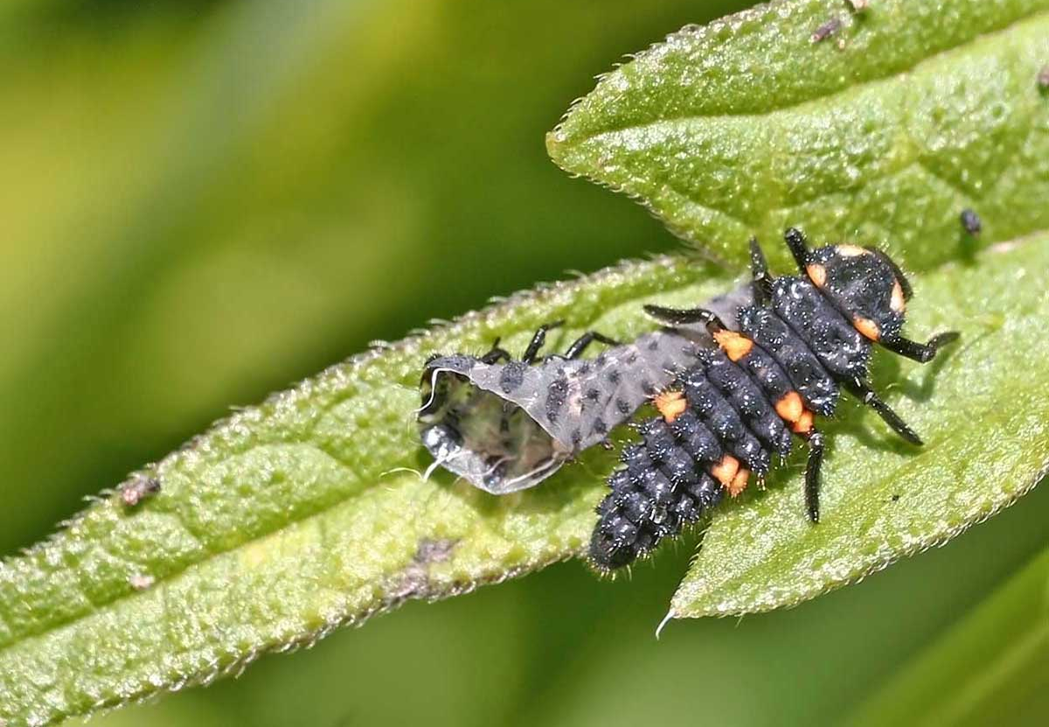
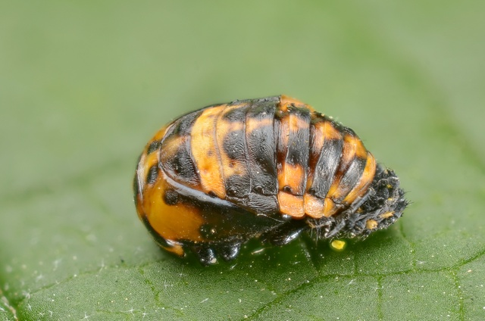
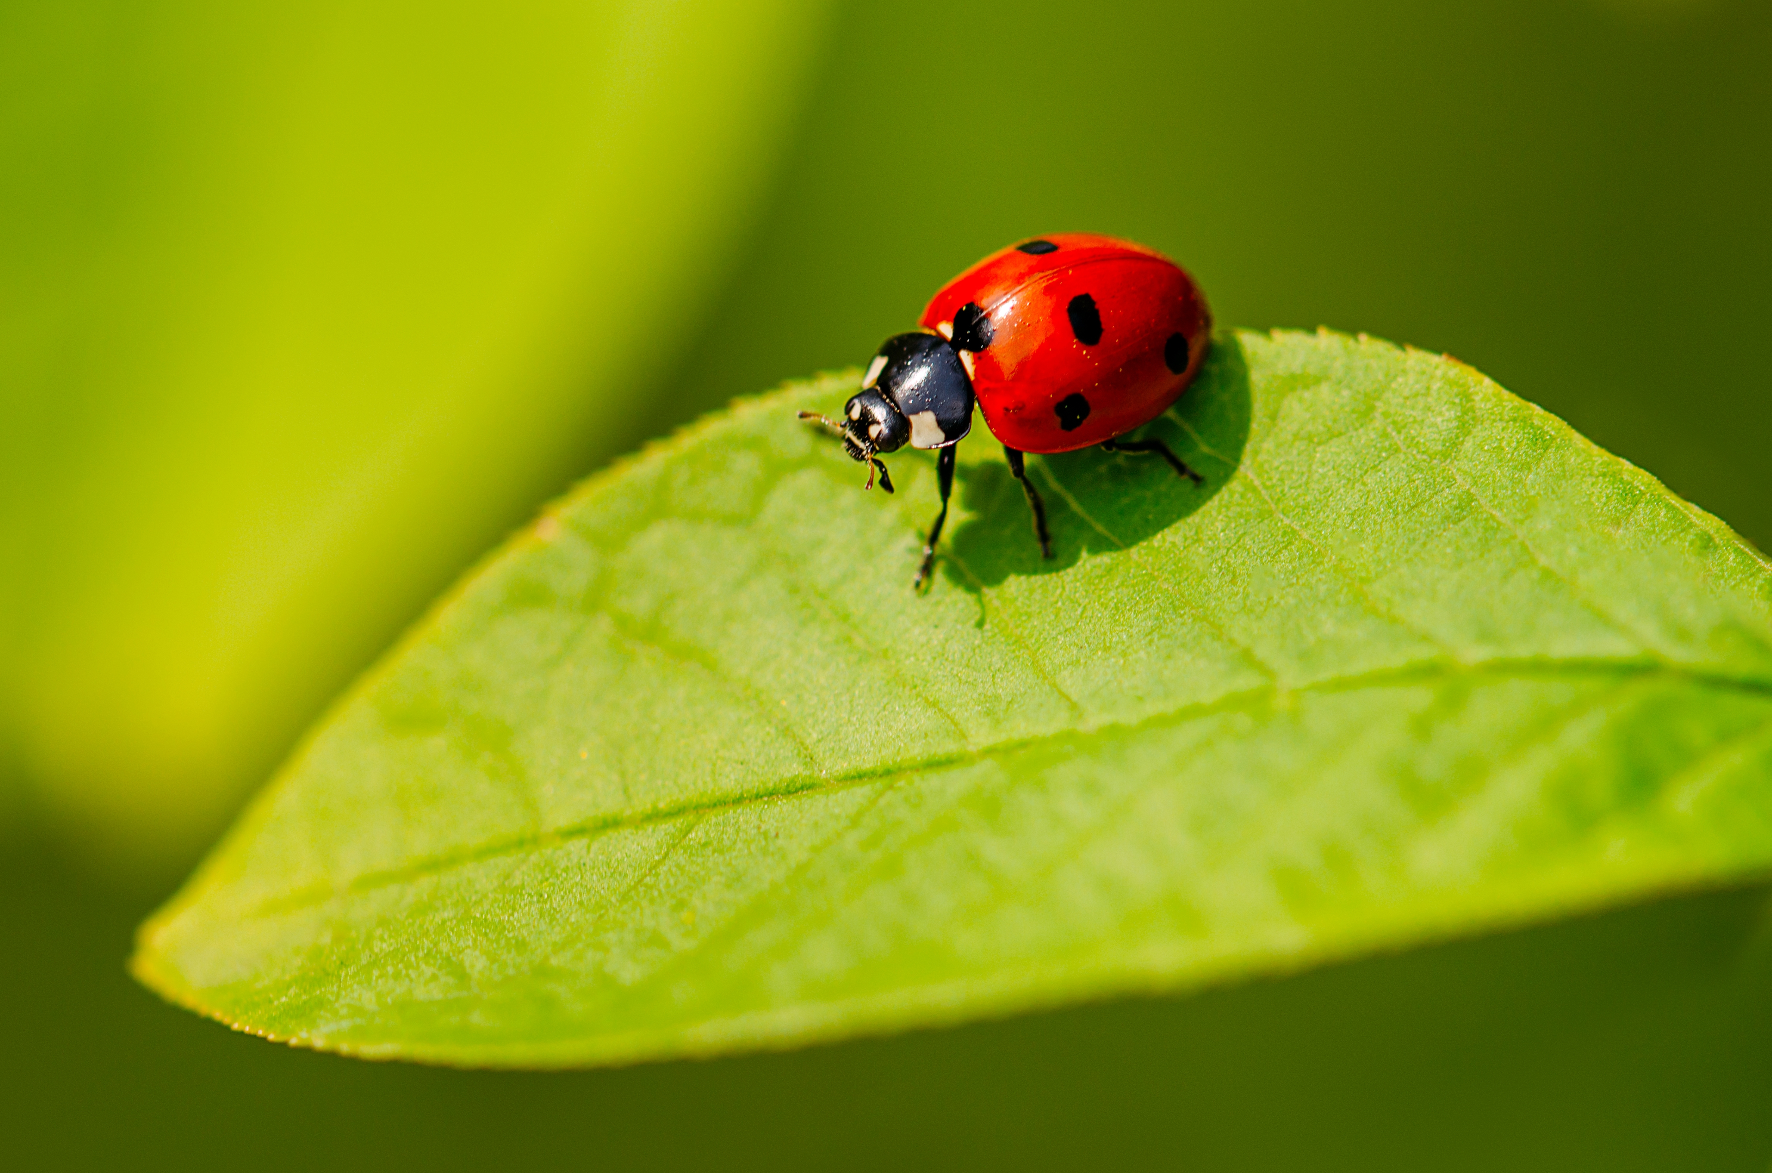
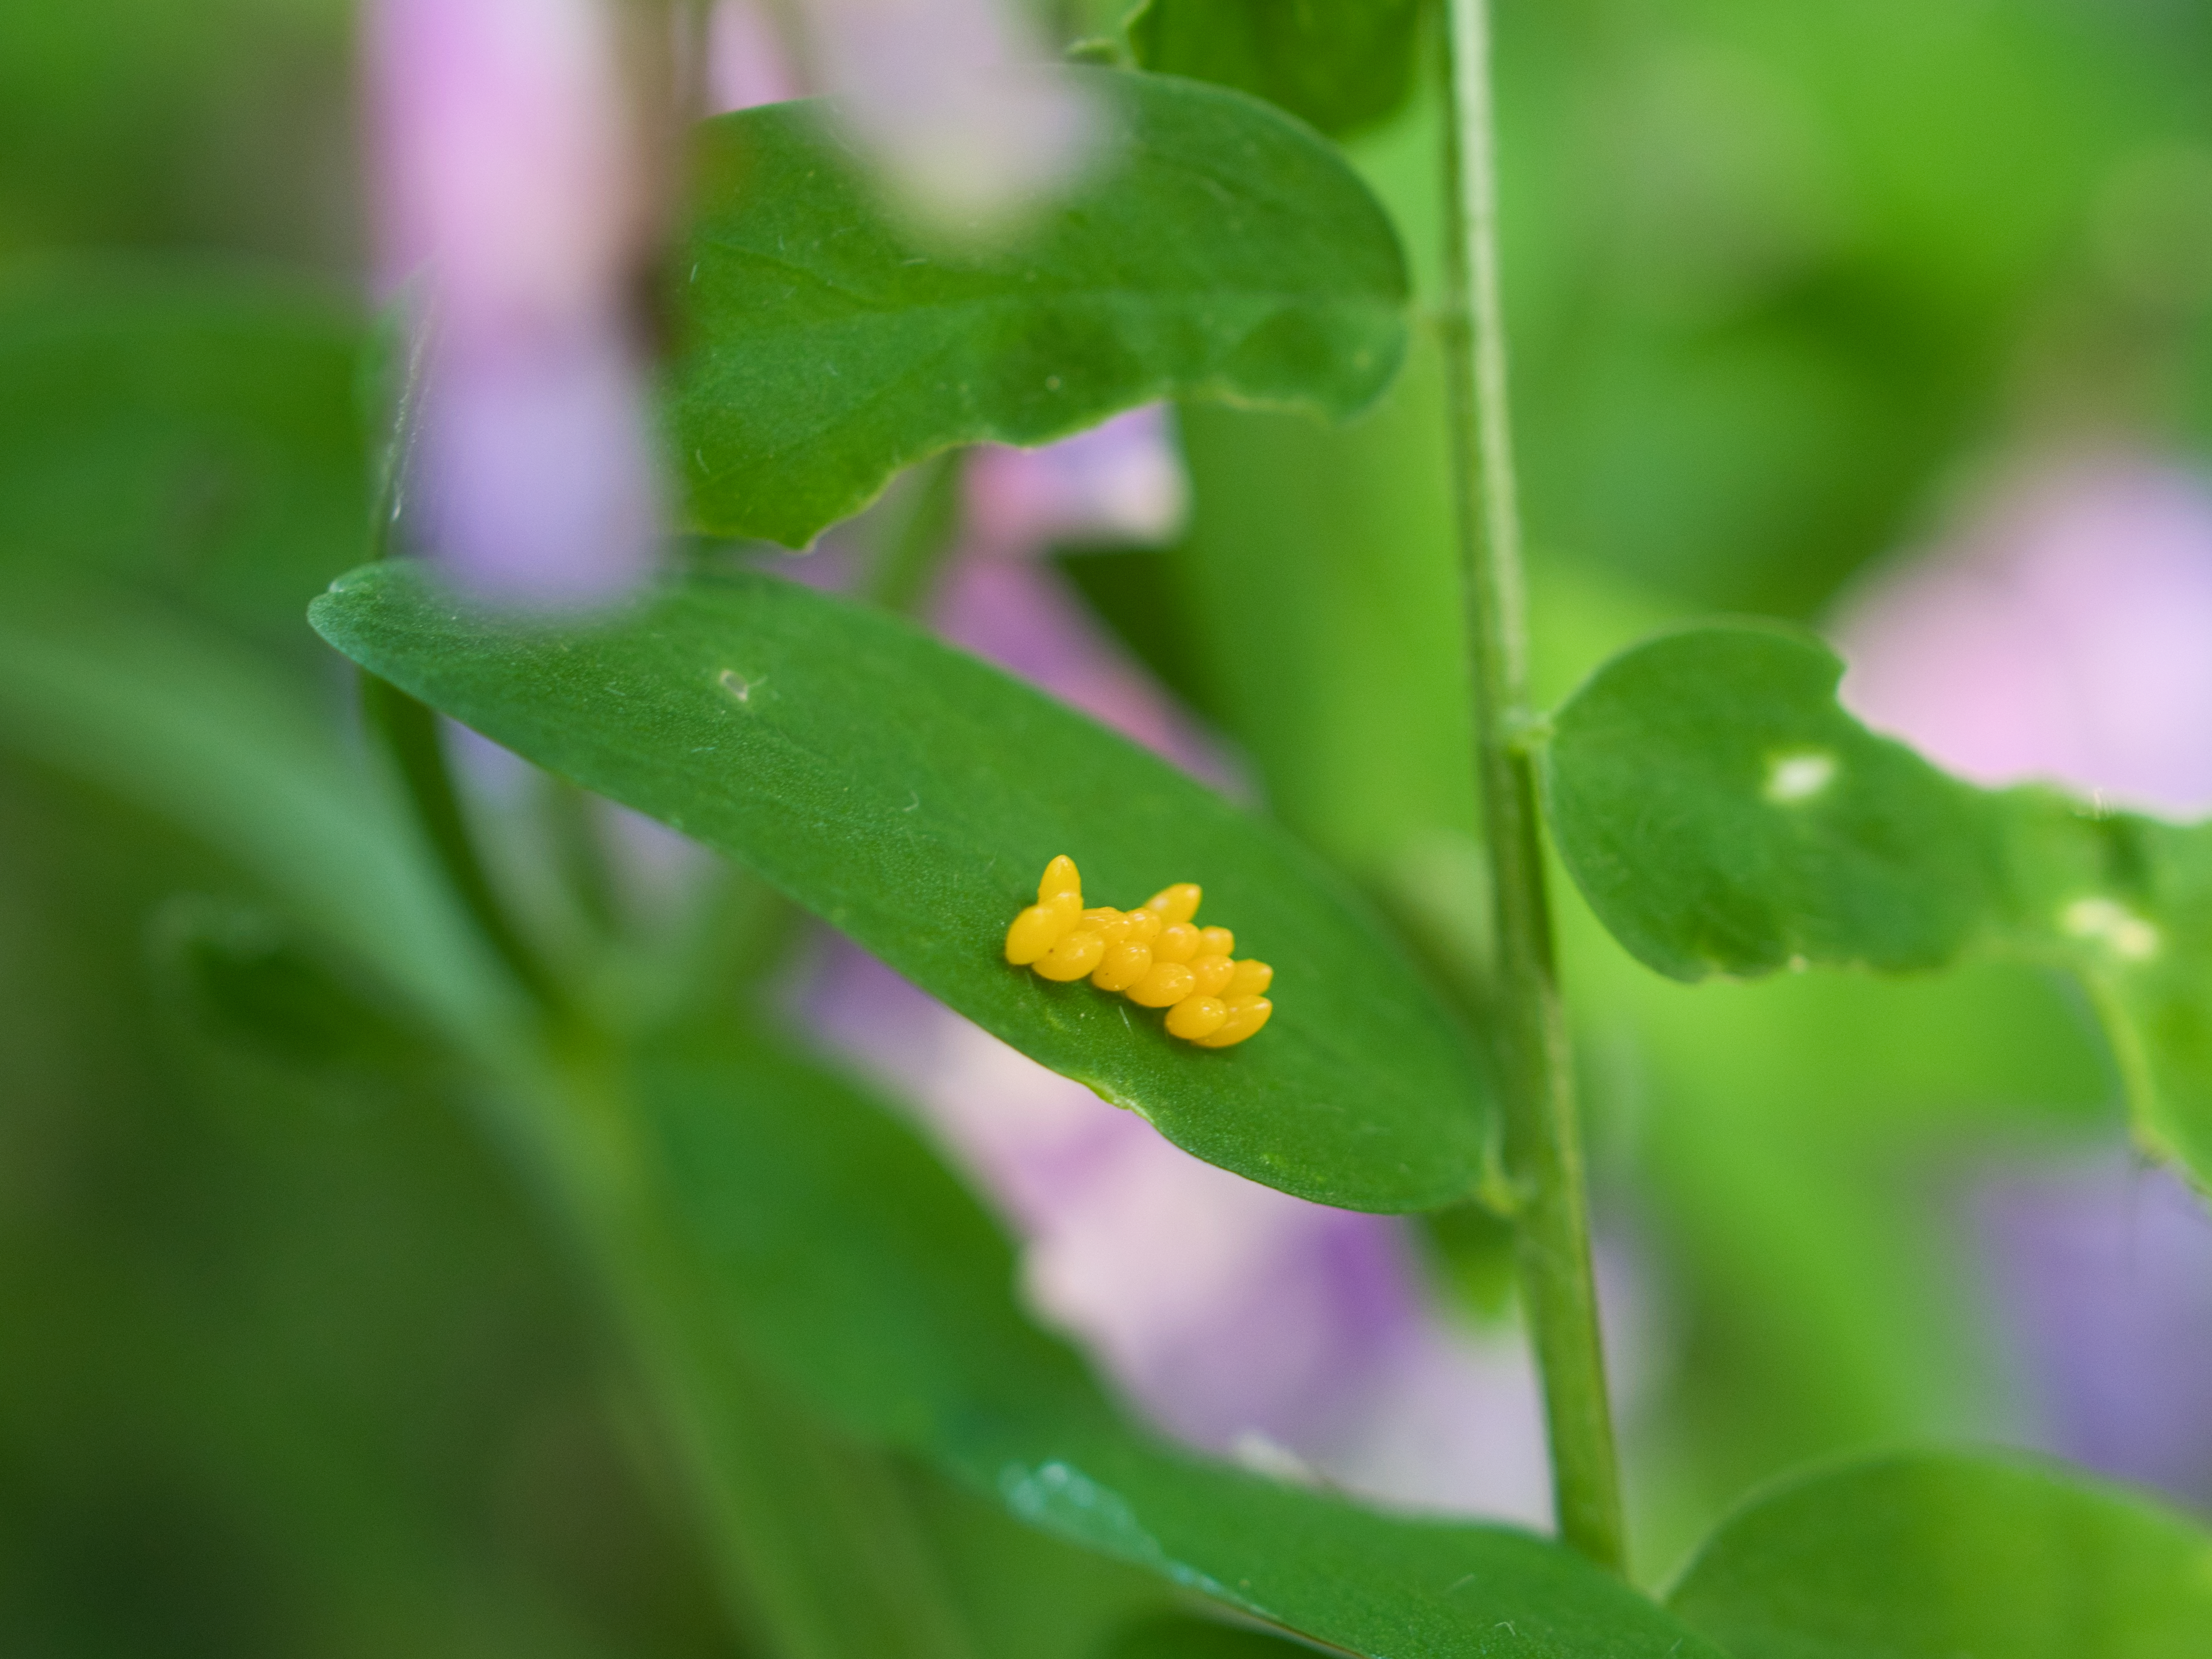
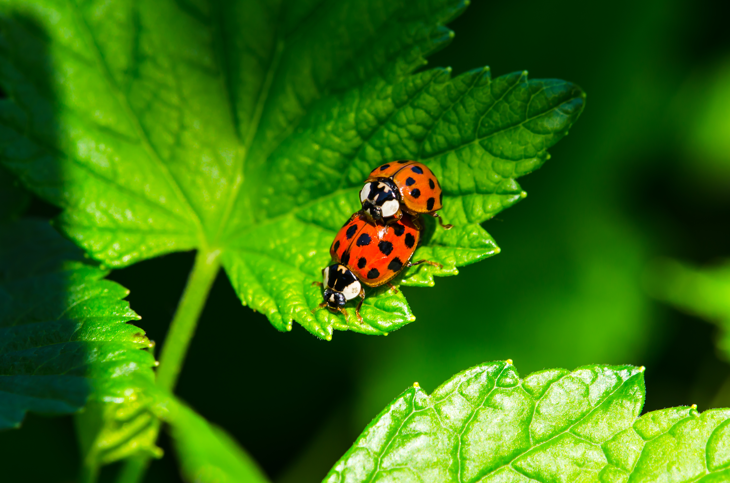
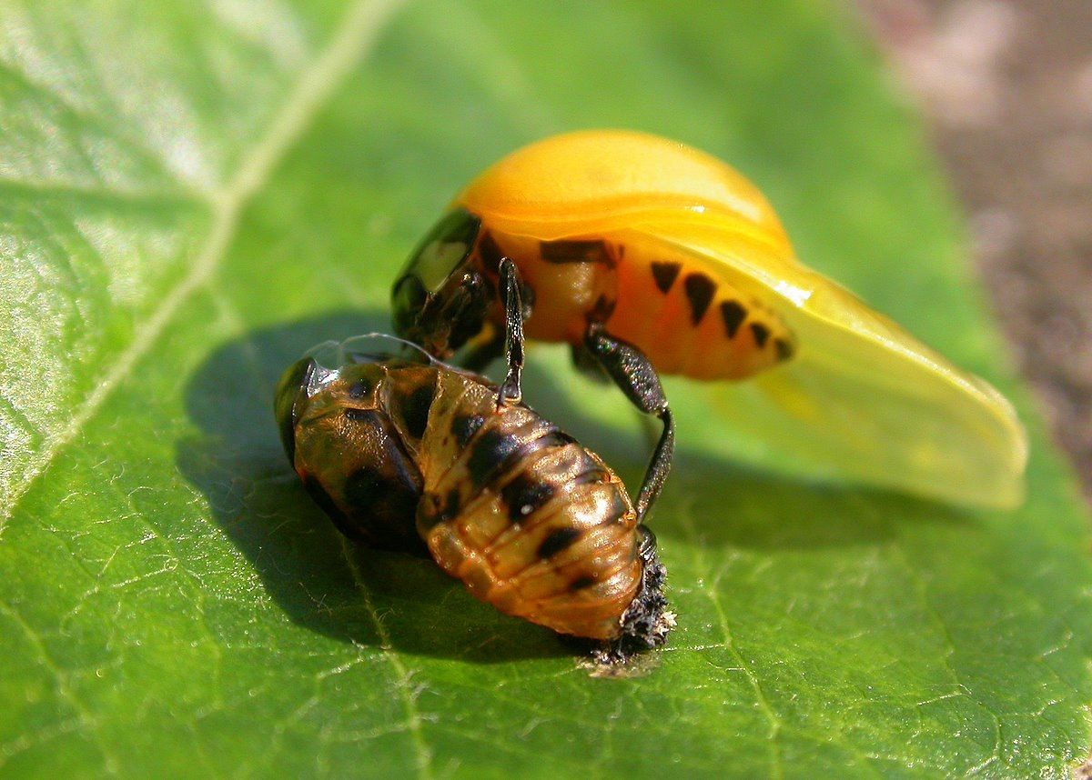
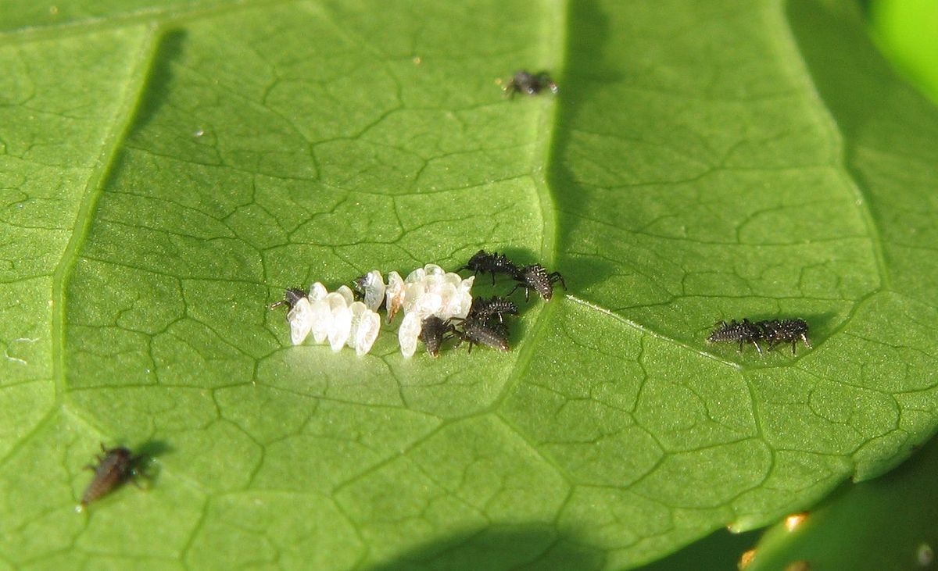
https://www.gerbeaud.com/faune/coccinelle-insecte-auxiliaire,1071.html
https://www.entomart.be/DIA-0001-01.html
https://www.techno-science.net/glossaire-definition/Coccinellidae.html
https://www.techno-science.net/glossaire-definition/Coccinellidae.html

Slide 2
https://www.gerbeaud.com/faune/coccinelle-insecte-auxiliaire,1071.html
https://www.entomart.be/DIA-0001-01.html
https://www.techno-science.net/glossaire-definition/Coccinellidae.html
https://www.techno-science.net/glossaire-definition/Coccinellidae.html

